Slide 1
Can we preserve reasoning integrity under efficiency and precision constraints?
Dengjia Zhang, Elisabeth Fittschen
Notes:
Hi — Welcome to the self-supervised learning class!

Slide 2
When Reasoning Meets Compression:
Understanding the Effects of LLM Compression on Large Reasoning Models
Zhang, et al.

Slide 3
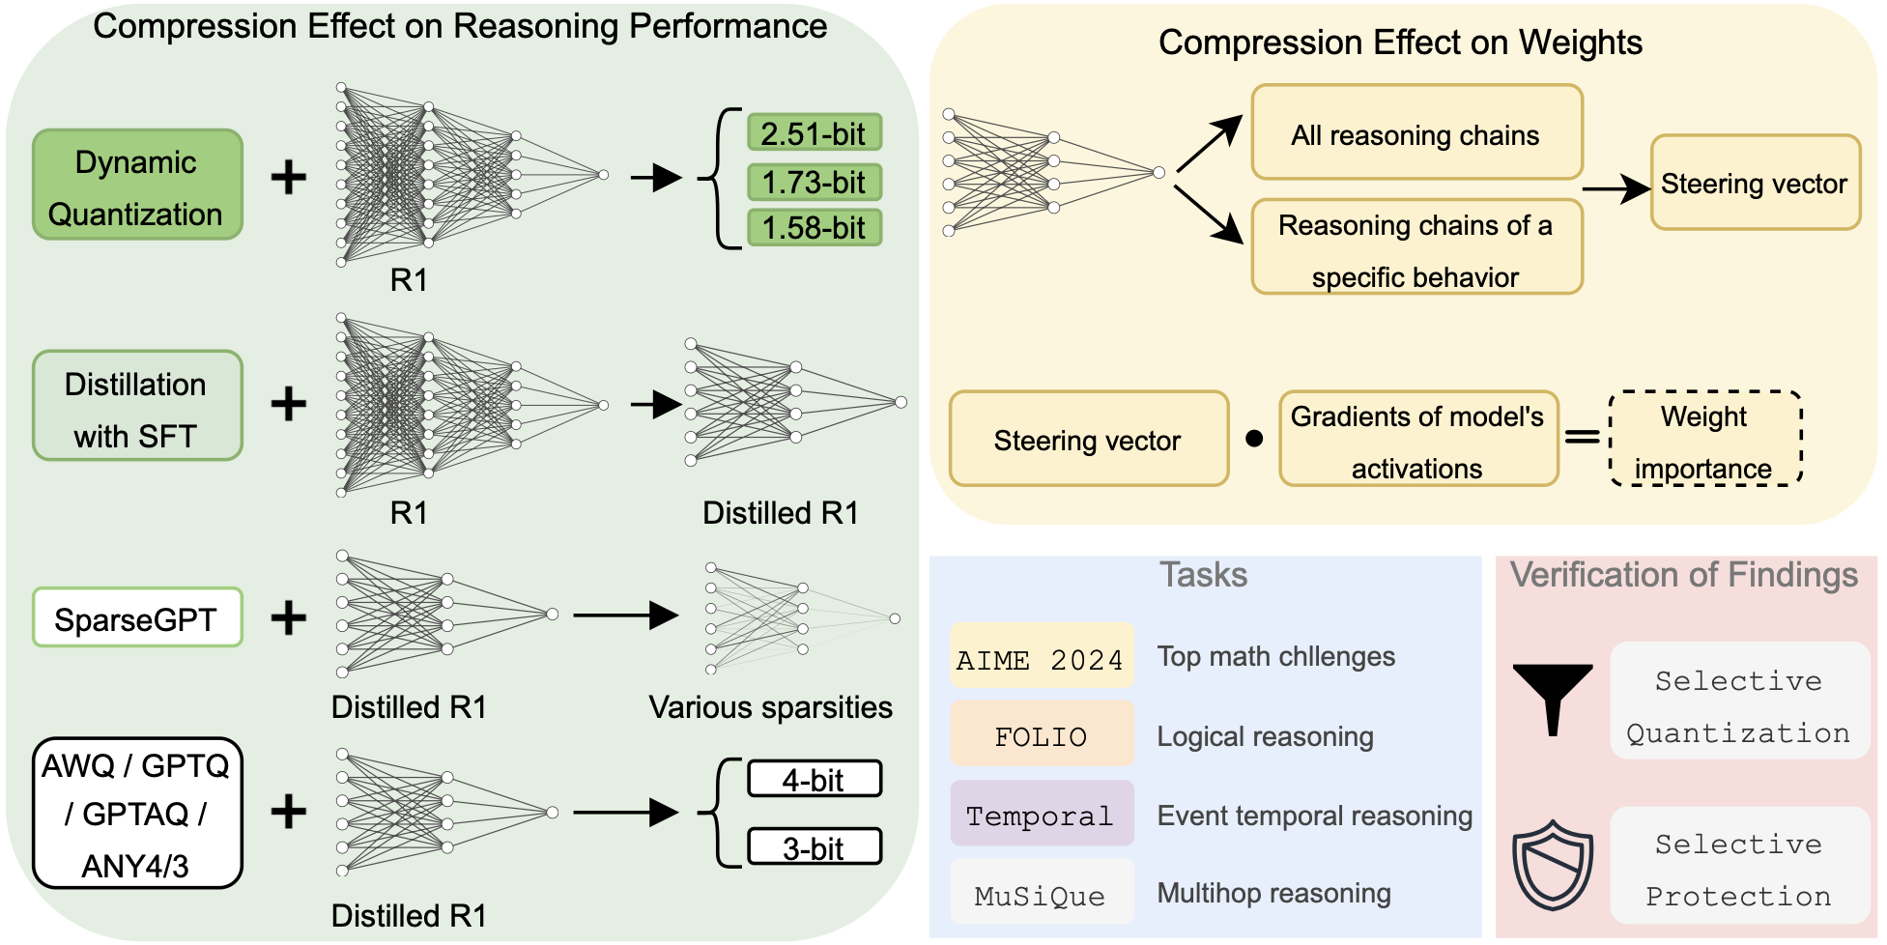
Big Picture
Two parts:
Benchmarking compression methods
Notes:
Paper is made up of two parts

Slide 4
Big Picture
Two parts:
Benchmarking compression methods
Estimating weight importance for reasoning

Slide 5
Background
Distillation:
Trainer/Student setup
Teacher logit distribution is used in addition to regular token prediction loss
 | Model Structure | Weights
Distillation | ❌ | ❌
Pruning
Quantization

Slide 6
Background
Pruning:
Removal of weights
Can be individual weights or larger structural components
 | Model Structure | Weights
Distillation | ❌ | ❌
Pruning | ❌ | ✅
Quantization

Slide 7
Background
Quantization:
Performed over original model
Weights are compressed from FP16/32 to 4/3/... -bit
 | Model Structure | Weights
Distillation | ❌ | ❌
Pruning | ❌ | ✅
Quantization | ✅ | ❌
Notes:
2 kinds of quantization
Quantisation of large models – by unsloth
Quantisation of smaller models – done by the authors them

Slide 8
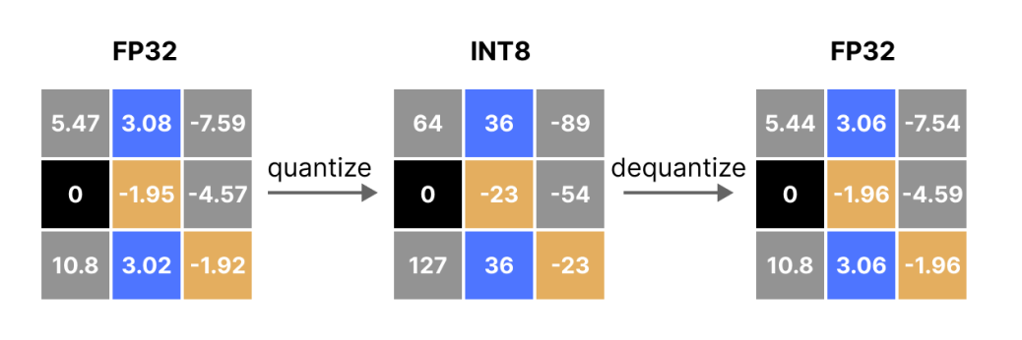
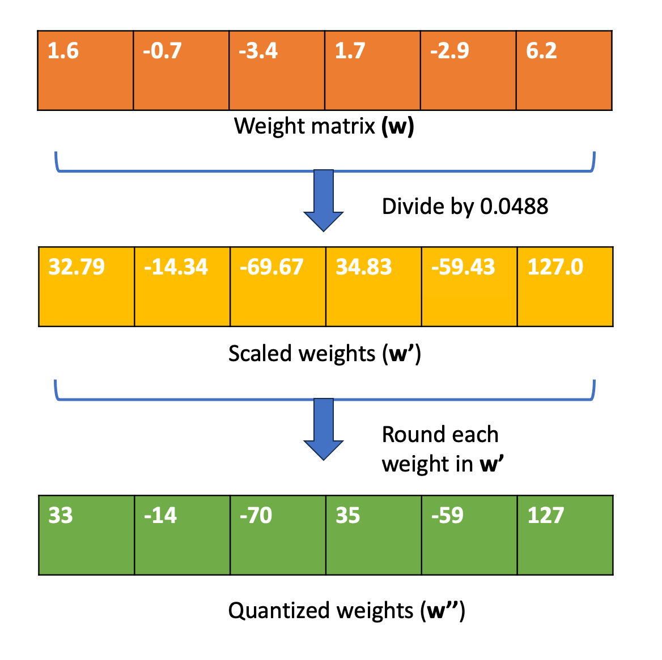
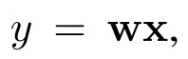
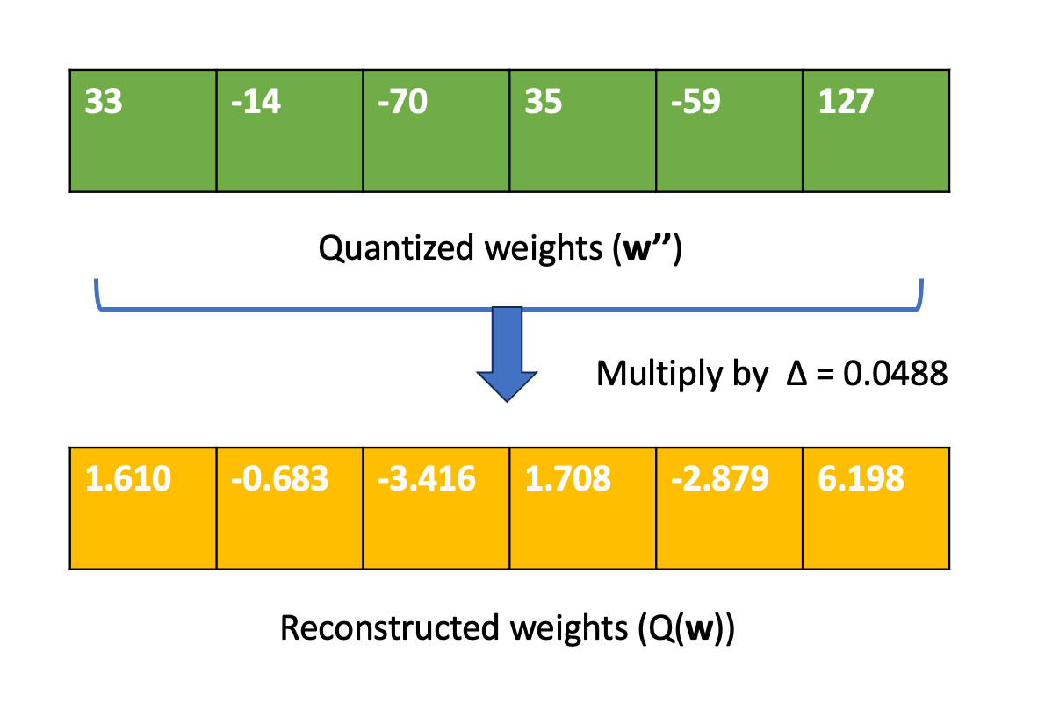
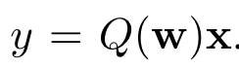
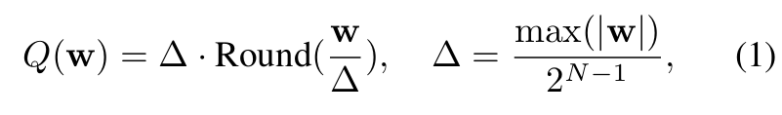
Background (Quantization)
Original layer:
Layer after Quantization:
Example function:

Slide 9
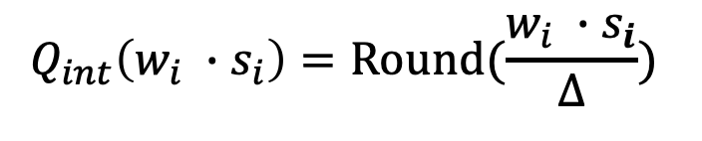
AWQ
AWQ: Activation-aware weight quantization
Some weights are more important than others.
Idea: weight importance is related to activation magnitude

Slide 10
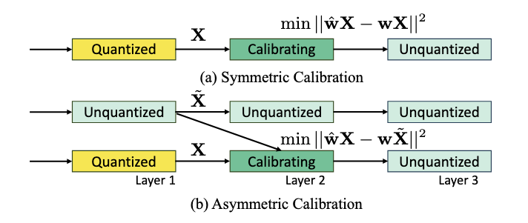
GPTQ / GPTAQ
Quantize ever layer in order, to reduce the layer output quantization error.
Leverages an approximation of the inverse Hessian to determine weight importance.
GPTQ
GPTAQ

Slide 11
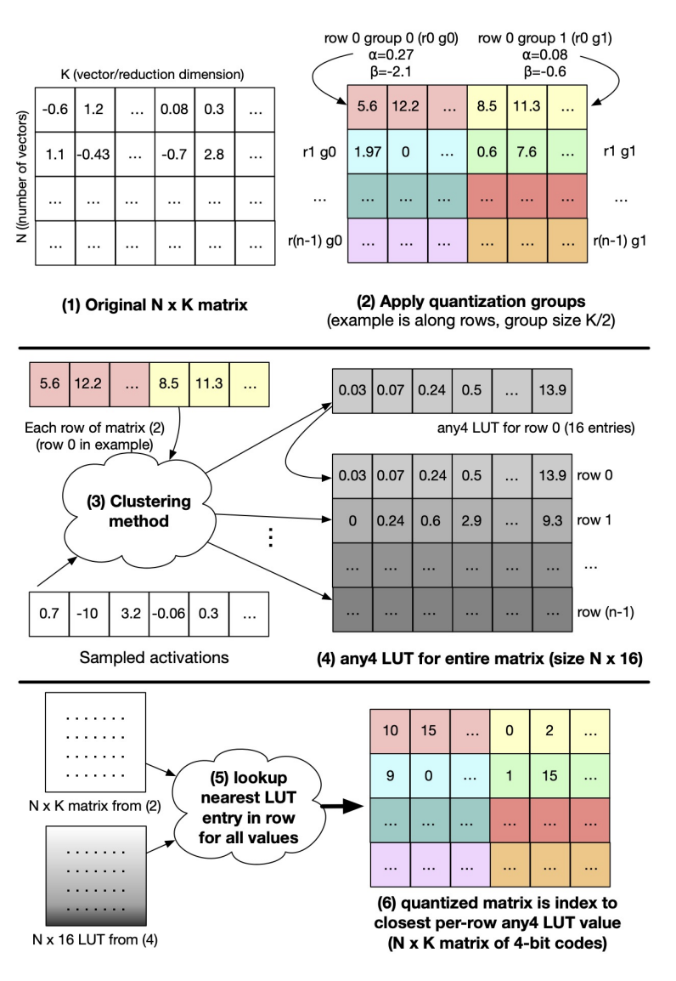
Any4/3
A lightweight table for quantization
No need to do preprocess for weights and activations
Learn distribution from data itself, not trying to match a distribution(nf4,af4)

Slide 12
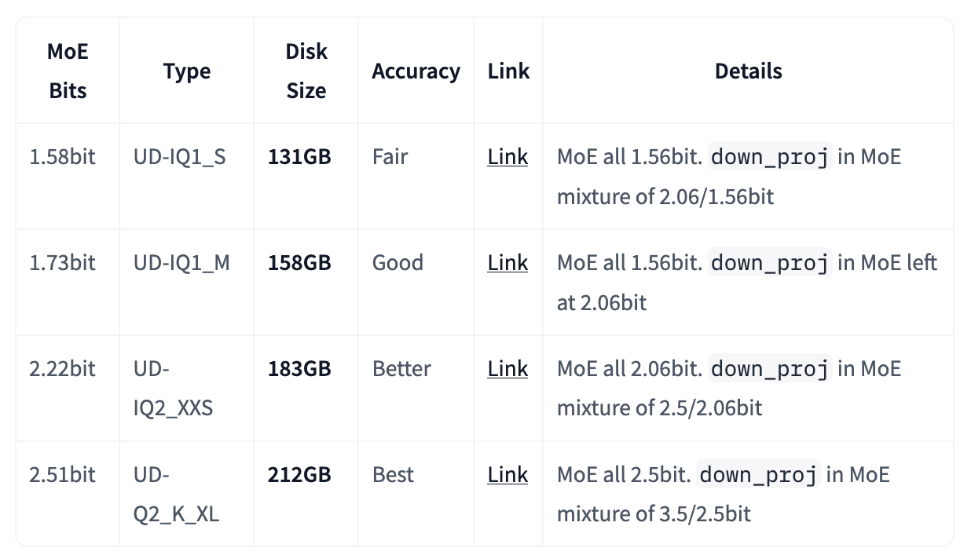
Dynamic
Some weights are more important than others:
down_project in the first 3-6 layers
Shared MoE layers
lm_head and Embeddings
Layer norms and MoE router
Notes:
https://unsloth.ai/blog/deepseekr1-dynamic

Slide 13
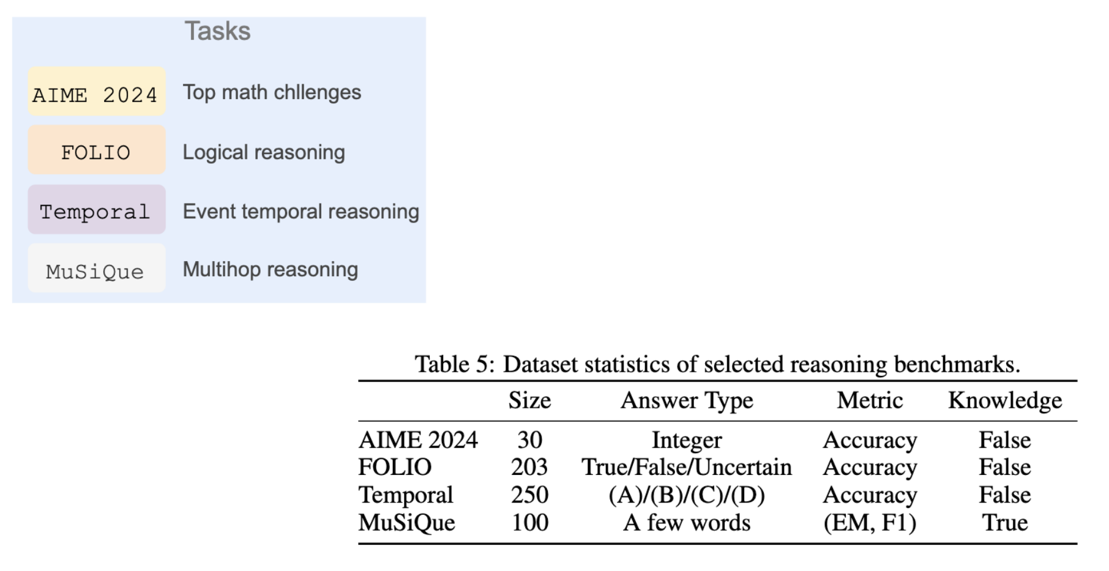
Data
Gpt-4o annotated outputs for:
Uncertainty Estimation
Adding Knowledge
Backtracking
Example Testing

Slide 14
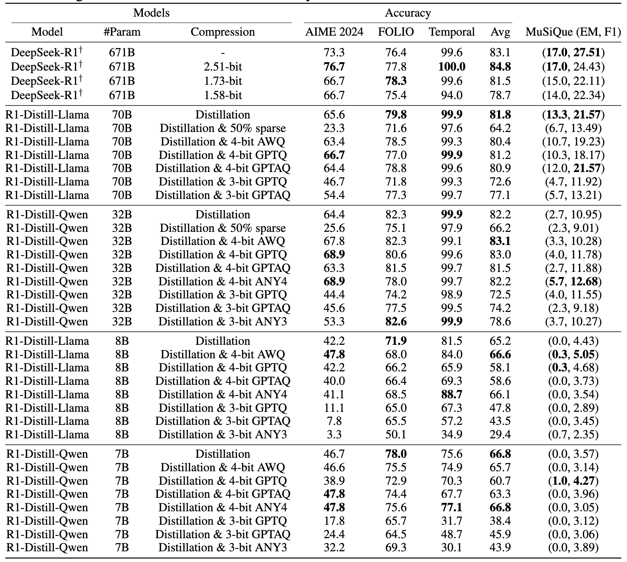
Results

Slide 15
Results
Pruning deteriorates performance

Slide 16
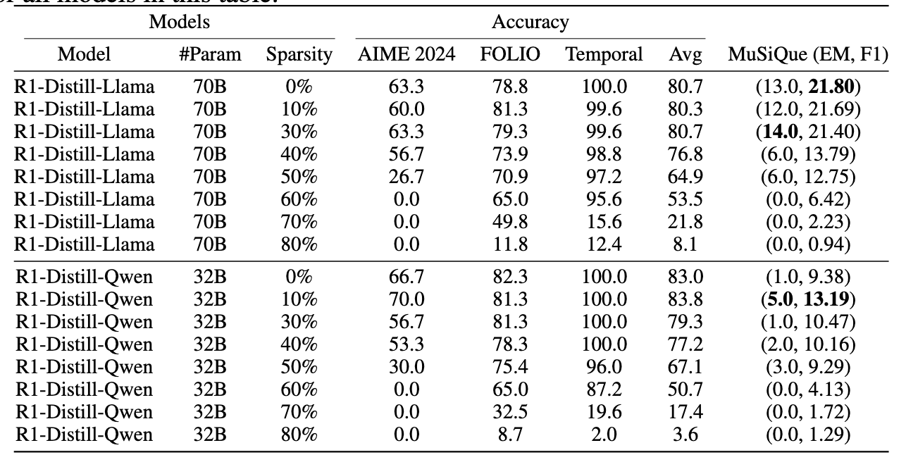
Results
Pruning deteriorates performance

Slide 17
Results
Pruning deteriorates performance
MuSiQue experiences the most significant performance drop
AIME 2024, collapses at 3-bit

Slide 18
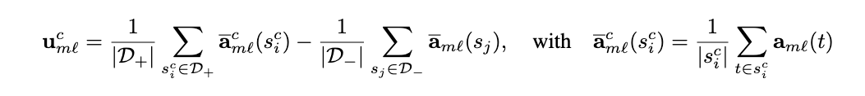
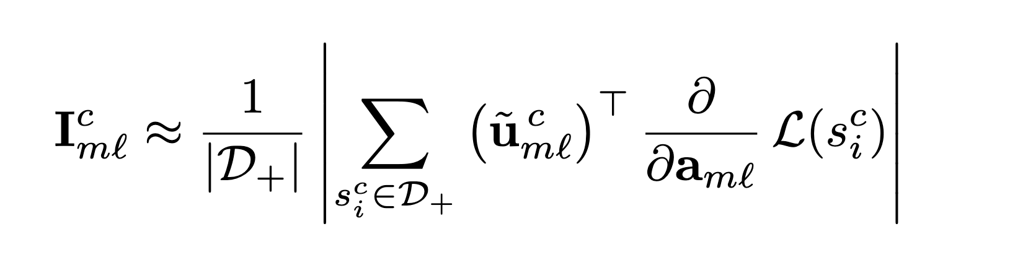
Background
Behaviors:
Uncertainty Estimation
Adding Knowledge
Backtracking
Example Testing
Difference of Means
Attribution Patching:

Slide 19
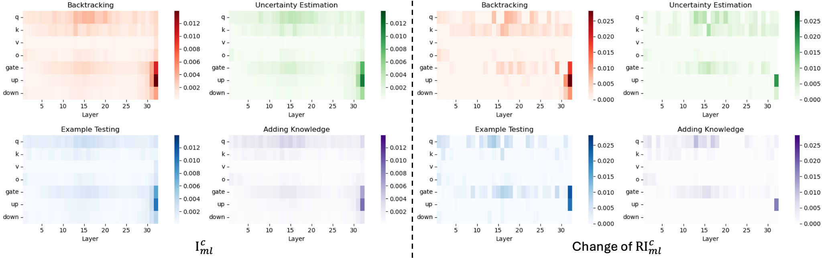
Importance Metric (compared to base)
32_up_project has the highest importance score for the evaluated behaviors
experiences the biggest change in importance

Slide 20
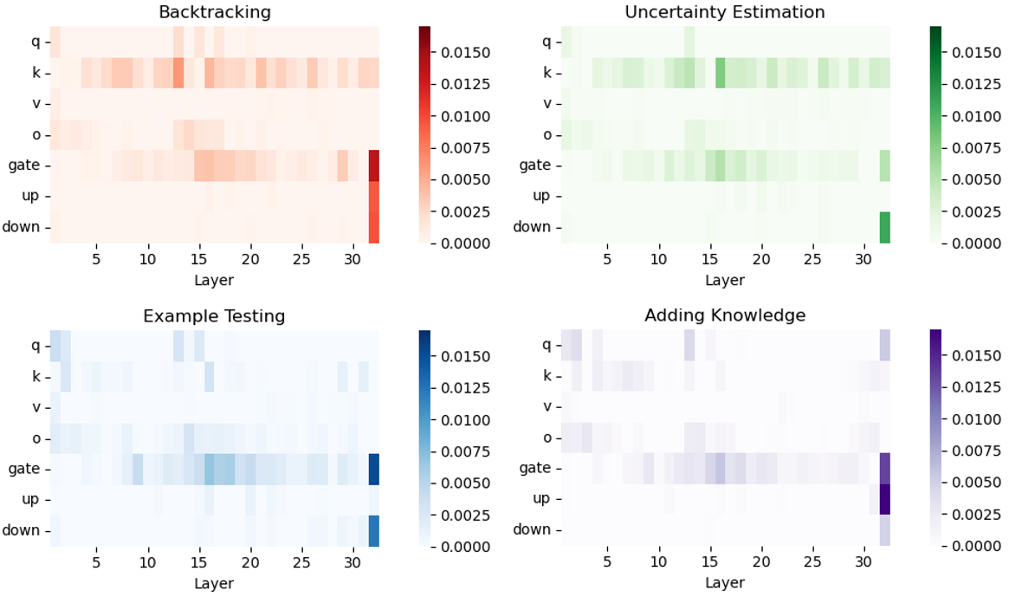
Importance Metric (compared to AWQ)
32_up_project importance is not preserved for 'Backtracking' and 'Adding Knowledge'

Slide 21
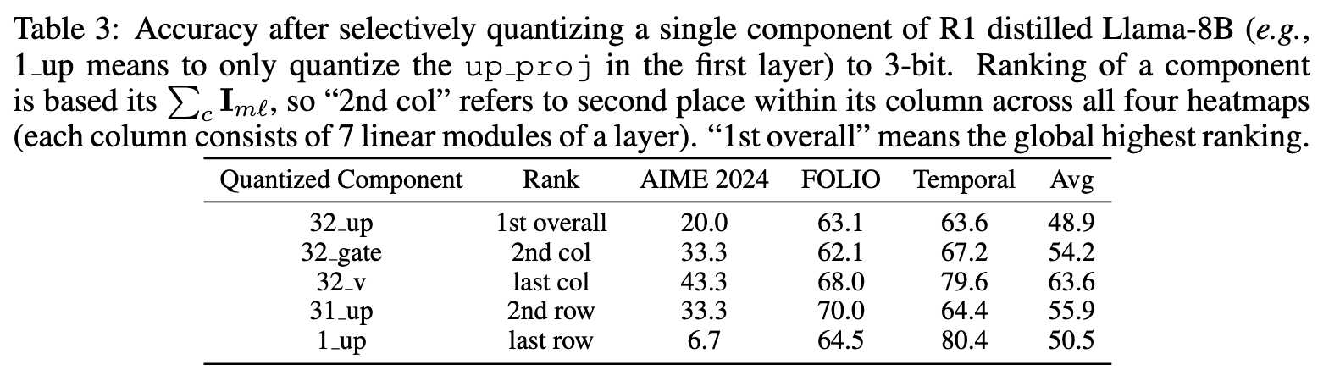
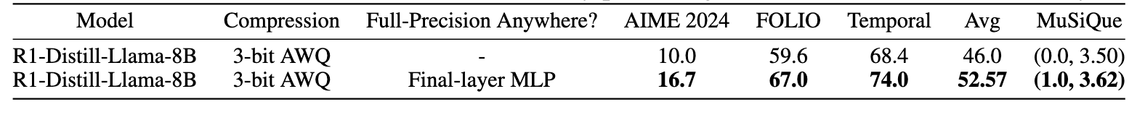
Verification/Results
Selectively quantizing components: (4bit)
Altering AWQ such that the final layer MLP is preserved: (3bit)

Slide 22
Understanding and Mitigating Numerical Sources of Nondeterminism in LLM Inference
Yuan, Jiayi, et al.

Slide 23
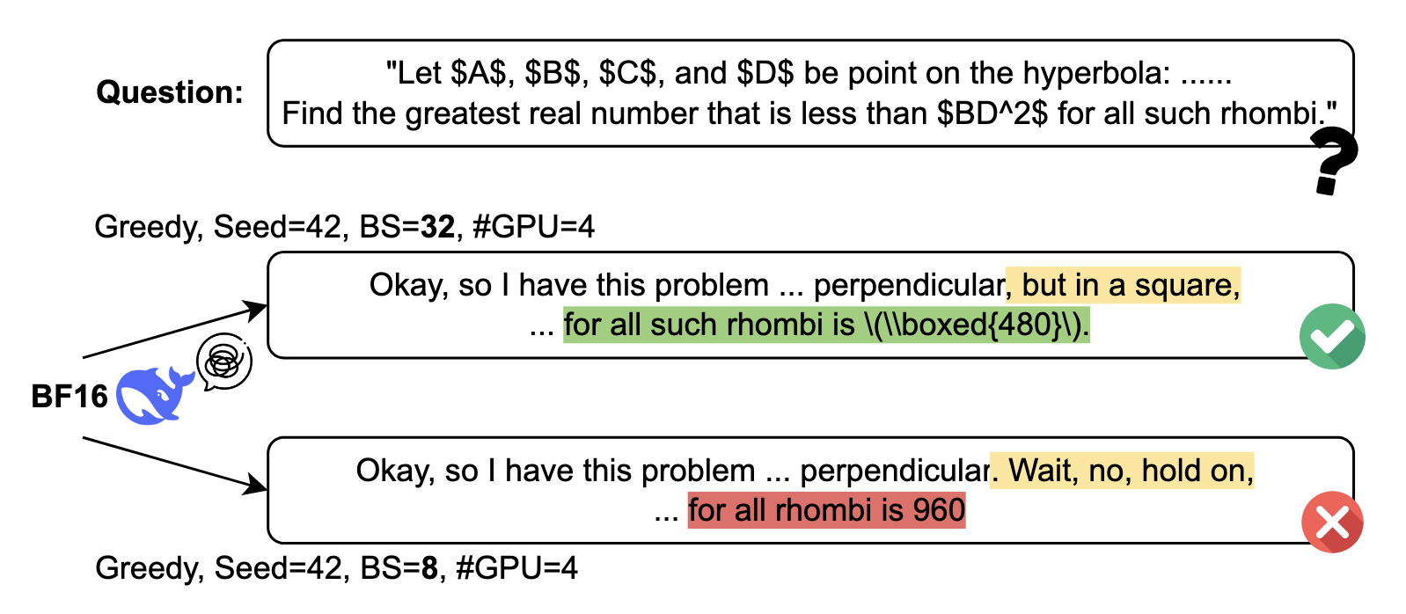
One sentence for the paper?
Different running configurations can lead to variation of results. (Live by FP32, die by FP32)

Slide 24
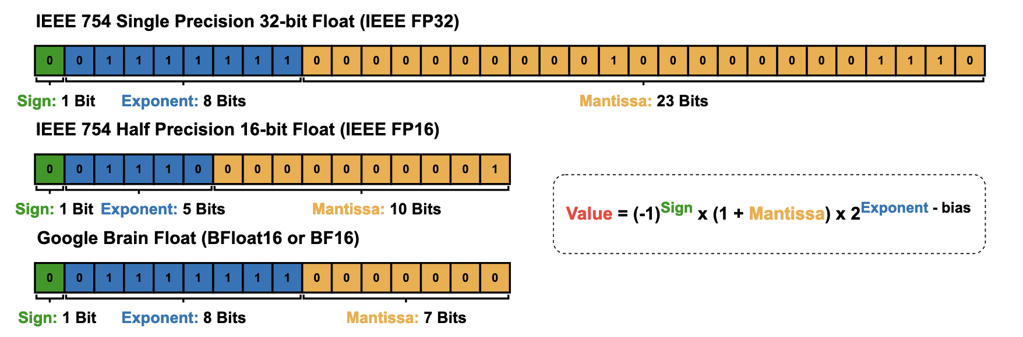
Precision
Larger Mantissa means more precise and Larger Exponent means larger range of values

Slide 25

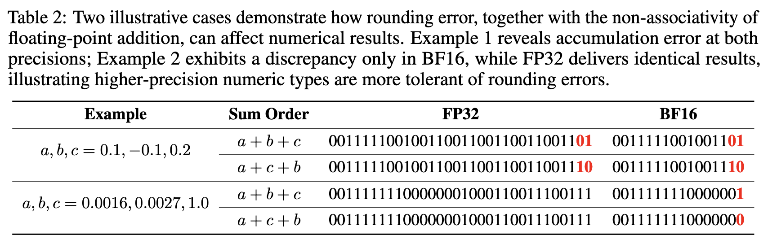
Precision
: O

Slide 26
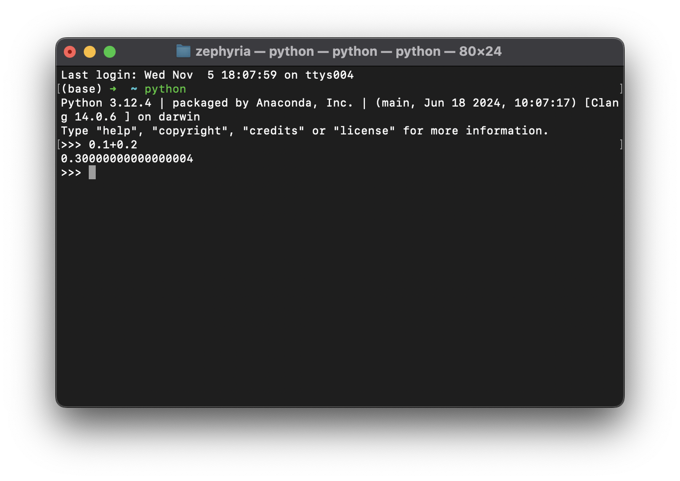
Precision

Slide 27
Experiment Settings
Models:
Reasoning Models:DeepSeek-R1-DistillQwen-7B, DeepSeek-R1-Distill-Llama-8B
Non-Reasoning Models: Qwen2.5-7B-Instruct, Llama-3.1-8B-Instruct
Benchmarks: AIME’24, MATH500, LiveCodeBench-[Easy,Medium,Hard]
Running Configurations
GPU Types: NVIDIA L40S, A100
GPU counts: 2, 4
Batch Sizes: 8, 16, 32

Slide 28
Experiment Metrics
Greedy Decoding:
Std@Acc(⬇): Standard deviation of accuracy
Avg_Std@Output_Length(⬇): Average standard deviation of output length
Div_Index(⬆): Model produce identical token sequences up to a certain position, but generate different tokens after that position
Avg_Std@top1_prob(⬇): Average standard deviation of top-1 token prediction probability(0 to Div_Index)
Random Sampling:
Pass@1(⬇): Standard deviation of Pass@1
Notes:
One might argue that while greedy decoding is vulnerable to token-level instability from numerical precision, random sampling might be less sensitive due to its intrinsic stochasticity.

Slide 29
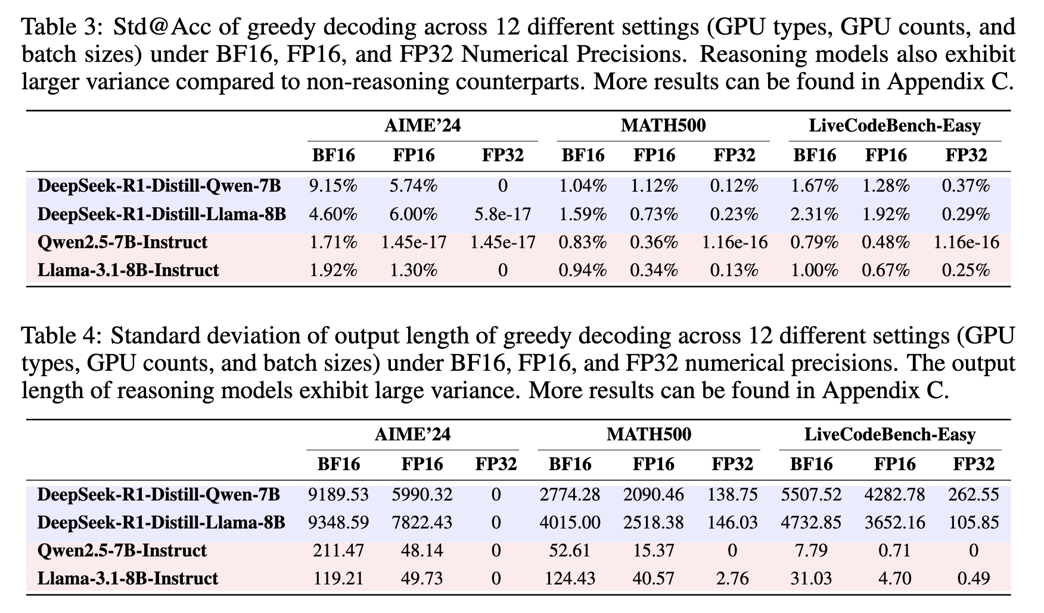
Greedy Decoding
FP32 helps a lot
BF16 exhibits substantial instability.

Slide 30
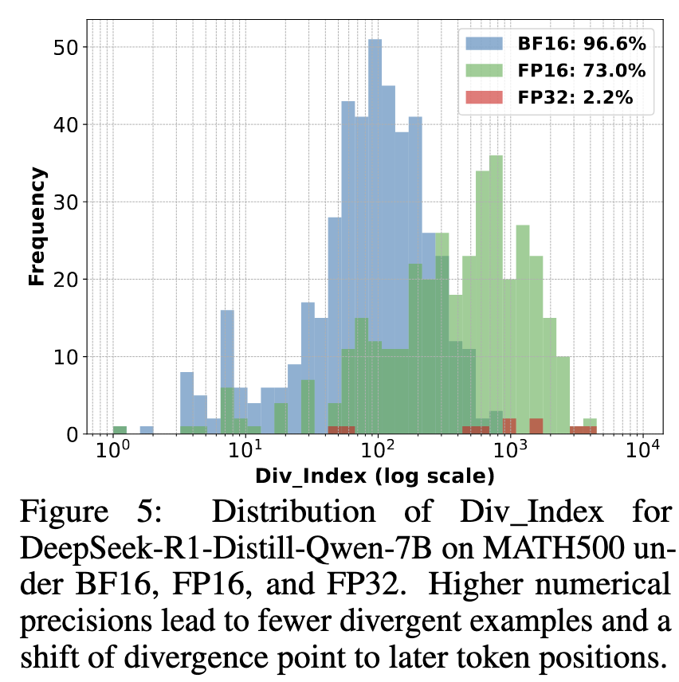
Greedy Decoding
Answer from BF16 will diverge more quickly
FP32 doesn't diverge too much

Slide 31
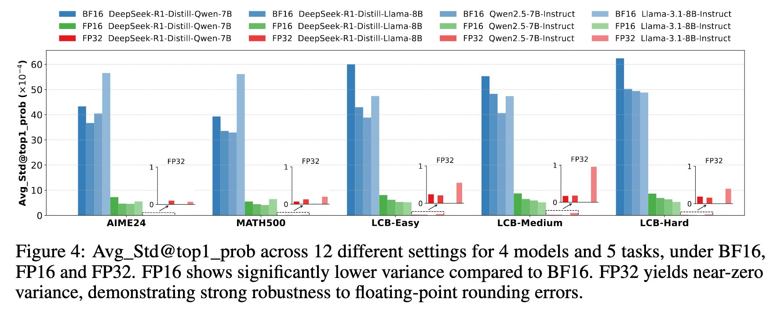
Greedy Decoding
FP32 helps a lot
BF16 exhibits substantial instability.

Slide 32
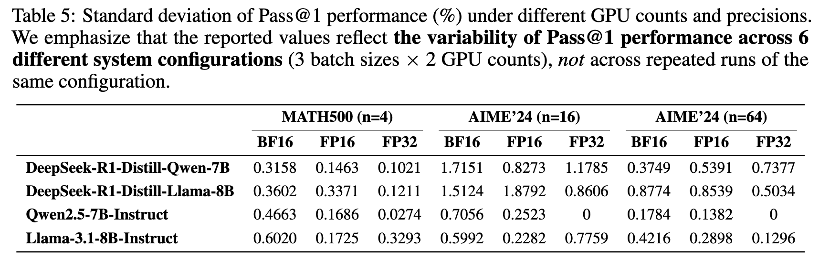
Random Sampling
Authors: result of dataset size and sampling dynamics, not contradiction

Slide 33
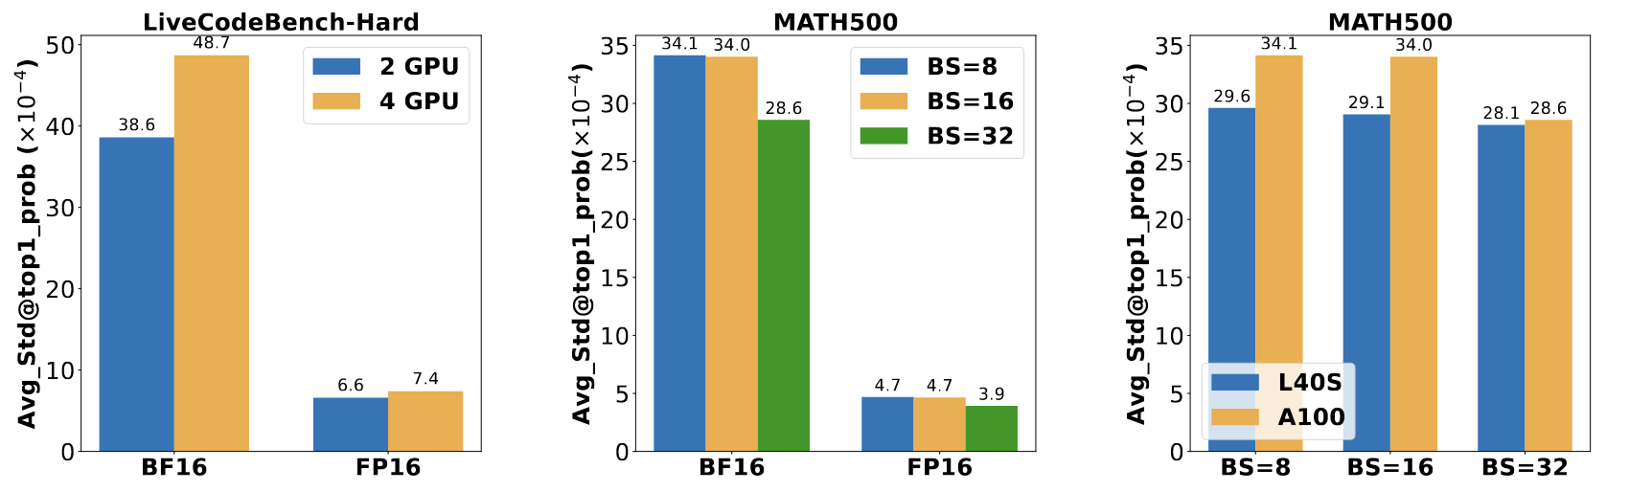
How Runtime Configurations Affect Reproducibility
More GPUs means more parallel computation
Smaller BS means more sequential processing steps
Hardware-level implementations and memory hierarchies count

Slide 34
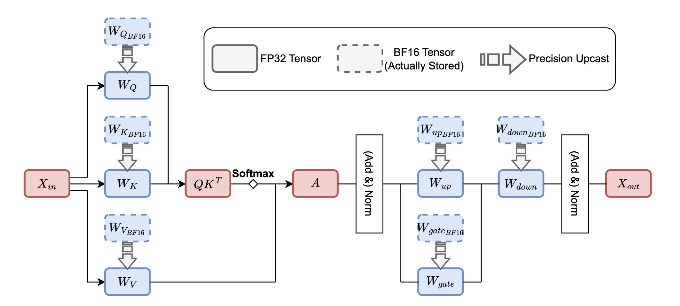
LayerCast
Store as BF16 and Compute as FP32

Slide 35
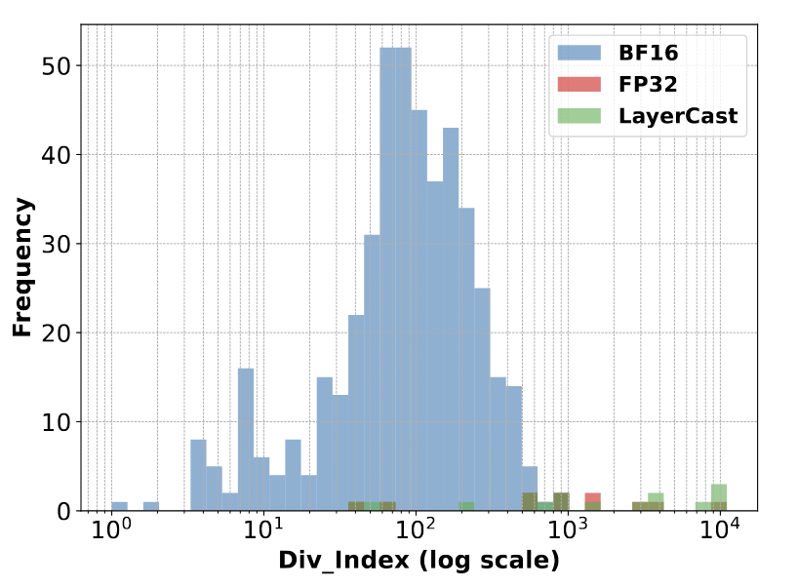
LayerCast
It is as good as FP32!

Slide 36
Disccusion
FP32, FP16 or BF16
What will be the result of INT8 or other quantization settings?
Compression
Does the compression metric make sense?
Does 'thinking' text actually represent what the model is doing.
Incorrect answers have longer chains of thought.
Calculate metric on the 4-bit model, apply change only to the 3-bit model.

